Slide 1
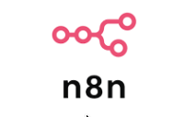



Autonomous AI Salesforce Developer Agent
Building an End-to-End Automated Salesforce Configuration System POC BY: Pratap Kumar Pattanayak Powered By:
Tooling Api

Slide 2

Executive Summary
The Challenge
- Manual Salesforce configuration is time-consuming and repetitive
- Developers spend hours creating custom fields, validation rules, and workflows
- Communication gaps between business users and technical teams
- Context switching between Jira, Salesforce, and development tools
The Solution
An autonomous AI agent that:
✅ Reads requirements from Jira Stories
✅ Asks clarifying questions automatically
✅ Generates Salesforce configurations using Claude AI
✅ Deploys directly to Salesforce via Tooling API
✅ Provides complete audit trail in Jira
This Photo by Unknown Author is licensed under CC BY-NC-ND

Slide 3

PoC Goals
Primary Objectives
Eliminate Manual Work-Automate 80%+ of routine Salesforce configurations
Improve Accuracy-AI-powered validation before deployment
Accelerate Delivery-Reduce configuration time from hours to minutes
Enhance Collaboration- Seamless Jira-to-Salesforce workflow
Human in Loop-Keeps human in loop though Jira discussion
24x7 Coverage
No Fatigue
No Vacation
No Office Politics
No Annual Bonus Demand

Slide 4
System Architecture
┌─────────────────────────────────────────────────────────────┐
│ WORKFLOW 2: Answer Processing (Webhook) │
│ ┌──────────────────────────────────────────────────────┐ │
│ │ 1. Jira Webhook: Comment added │ │
│ │ 2. Bot Detection: Skip bot's own comments │ │
│ │ 3. Extract Q&A from comments │ │
│ │ 4. Claude AI: Re-analyze with answers │ │
│ │ 5. Parse response │ │
│ │ 6. Decision: More questions? │ │
│ └──────────┬───────────────────────┬───────────────────┘ │
│ │ YES │ NO │
│ ▼ ▼ │
│ Post More Questions Add "ready-to-execute" │
│ Trigger Workflow 3 │
└─────────────────────────────────────┬───────────────────────┘
└─────────────────────────────────────────────────────────────┘
┌─────────────────────────────────────────────────────────────┐
│ JIRA STORY CREATED │
│ (Label: "salesforce", Type: Story) │
└─────────────────────┬───────────────────────────────────────┘
┌─────────────────────────────────────────────────────────────┐
│ WORKFLOW 1: Initial Analysis │
│ ┌──────────────────────────────────────────────────────┐ │
│ │ 1. Jira Trigger (polls every 1 min) │ │
│ │ 2. Claude AI: Analyze requirement │ │
│ │ 3. Parse AI response (JSON) │ │
│ │ 4. Decision: Questions needed? │ │
│ └──────────┬───────────────────────┬───────────────────┘ │
│ │ YES │ NO │
│ ▼ ▼ │
│ Post Questions to Jira Add "ready-to-execute" label │
│ Add "awaiting-response" Trigger Workflow 3 │
└─────────────┬───────────────────────────────────────────────┘
┌─────────────────────────────────────────────────────────────┐
│ WORKFLOW 3: Execute Changes (Webhook) │
│ ┌──────────────────────────────────────────────────────┐ │
│ │ 1. Webhook: Receives issueKey + execution plan │ │
│ │ 2. Jira: Get issue details │ │
│ │ 3. Verify "ready-to-execute" label │ │
│ │ 4. Post "Execution started" comment │ │
│ │ 5. Update label to "in-progress" │ │
│ │ 6. Claude AI: Generate Tooling API metadata │ │
│ │ 7. Parse metadata (JSON) │ │
│ │ 8. Prepare Tooling API request │ │
│ │ 9. Deploy via Salesforce Tooling API │ │
│ │ 10. Check deployment result │ │
│ └──────────┬───────────────────────┬───────────────────┘ │
│ │ SUCCESS │ FAILED │
│ ▼ ▼ │
│
Key Components:
3 n8n workflows:Initial Analysis, Answer Processing, Execute Changes
Claude Sonnet 4.5: Requirement analysis and metadata generation
Jira: Issue tracking and state management
Salesforce Tooling API: Direct deployment to Salesforce
Post success comment Post error comment │
│ Mark "completed" Add "error" label │
│ Transition to Done Keep for manual review │

Slide 5
Tech STACK
 | Workflow automation platform | 2.6.2 (Cloud) |
 | AI for requirement analysis | API 2023-06-01 |
 | Project management & state tracking | Cloud |
 | Direct metadata deployment | v64.0 |
 | Org authentication | Latest |
Tooling Api
CLI

Slide 6
Intelligent Q&A System (How it Works)
User creates Jira Story:
"Add Customer Segment field to Account"
Claude AI analyzes and asks:
"I need clarification on the following:
User answers in Jira comment
"Picklist with values: Enterprise, Mid-Market,
Claude AI confirms:
"All questions answered! Ready to execute. Execution Plan:
Automatic Deployment to Salesforce
As part of this POC, this changes configuration autonomously and deploys to production. This can be automated through a CICD pipeline with additional steps such as UAT in a lower environment
1. What type of field should this be (Text, Picklist, etc.)?
2. If Picklist, what are the values?
3. Should this field be required?
4. What should be the default value?"
Small Business, Startup.
Default: Small Business.
Not required."
1. Create picklist field 'Customer_Segment__c'
2. Add values and set default
3. Make field optional
Infinite Loop Prevention
AI Agent detects its own comments
Smart parsing
Handles Jira's ADF (Atlassian Document Format)
Context retention
Remembers previous questions and answers
Validation
Ensures all required information is gathered

Slide 7
Jira Label-Based Workflow State
Label | Meaning | Set By | Next Action
`salesforce` | SF-related issue | Human | Triggers Workflow 1
sf-agent-awaiting-response | Waiting for user answers | Workflow 1/2 | Triggers Workflow 2 on comment
sf-agent-ready-to-execute | All info gathered | Workflow 2 | Triggers Workflow 3
sf-agent-in-progress | Currently deploying | Workflow 3 | Don't re-trigger
sf-agent-completed | Successfully deployed | Workflow 3 | Issue Done
sf-agent-error | Error occurred | Any workflow | Human review
BENEFITS
Visual Tracking:
See agent status at a glance in Jira
Prevents duplicates:
Jira labels prevent re-processing
Audit trail:
Complete history of agent actions
Manual override:
Humans can change labels if needed

Slide 8
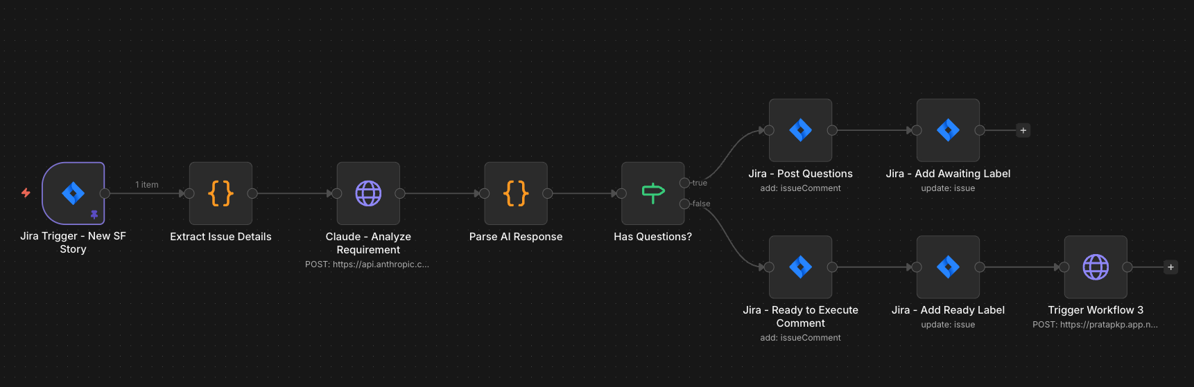
Claude AI Prompting Strategy
Workflow 1
Prompt 1: Initial Analysis (Workflow 1):
You are an expert Salesforce developer agent.
Analyze this Jira Story and determine requirements.
Respond in JSON format:
{
"isValid": true/false,
"configType": ["customField", "validationRule"],
"summary": "Brief summary",
"questions": ["Question 1?", "Question 2?"],
"readyToExecute": true/false
}

Slide 9
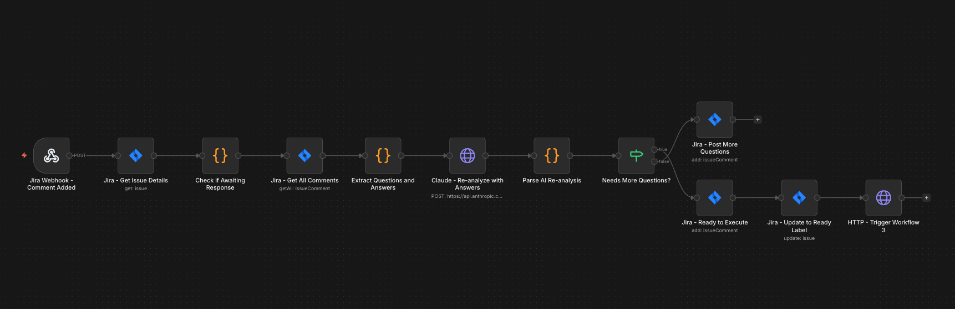
Claude AI Prompting Strategy
Workflow 2
Prompt 2: Answer Processing (Workflow 2)
Review the user's answers and determine next steps.
Respond in JSON format:
{
"allQuestionsAnswered": true/false,
"additionalQuestions": ["Question 3?"],
"readyToExecute": true/false,
"executionPlan": "Step by step plan",
"sfObjectsAffected": ["Account"],
"estimatedComplexity": "low/medium/high"
}

Slide 10
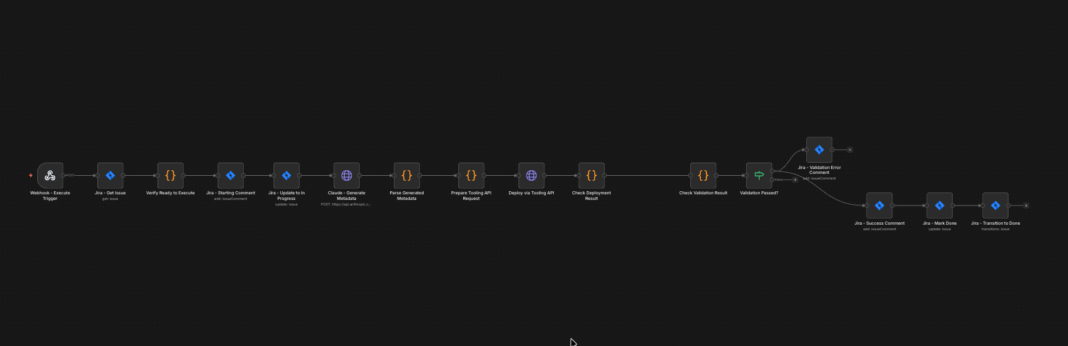
Claude AI Prompting Strategy
(Workflow 3)
Prompt 3: Generate Metadata (Workflow 3)
Generate Salesforce Tooling API metadata in JSON format.
Output Format:
{
"metadata": [{
"type": "CustomField",
"objectName": "Account",
"fieldName": "My_Field__c",
"fieldType": "Picklist",
"picklistValues": [
{"fullName": "Value1", "default": true, "label": "Value 1"}
]
}],
"verificationSteps": ["Step 1", "Step 2"]
}

Slide 11
Implementation Method
Total Dev Time | 3 Days
Workflows Created | 3 (42 nodes total)
Code Nodes | 8 custom JavaScript functions
AI Prompts | 3 specialized prompts
API Integrations
Jira API | 15 nodes
Anthropic API | 3 nodes (Claude)
Salesforce API | 2 nodes (Tooling API, OAuth2)
HTTP Webhooks | 3 inter-workflow triggers

Slide 12
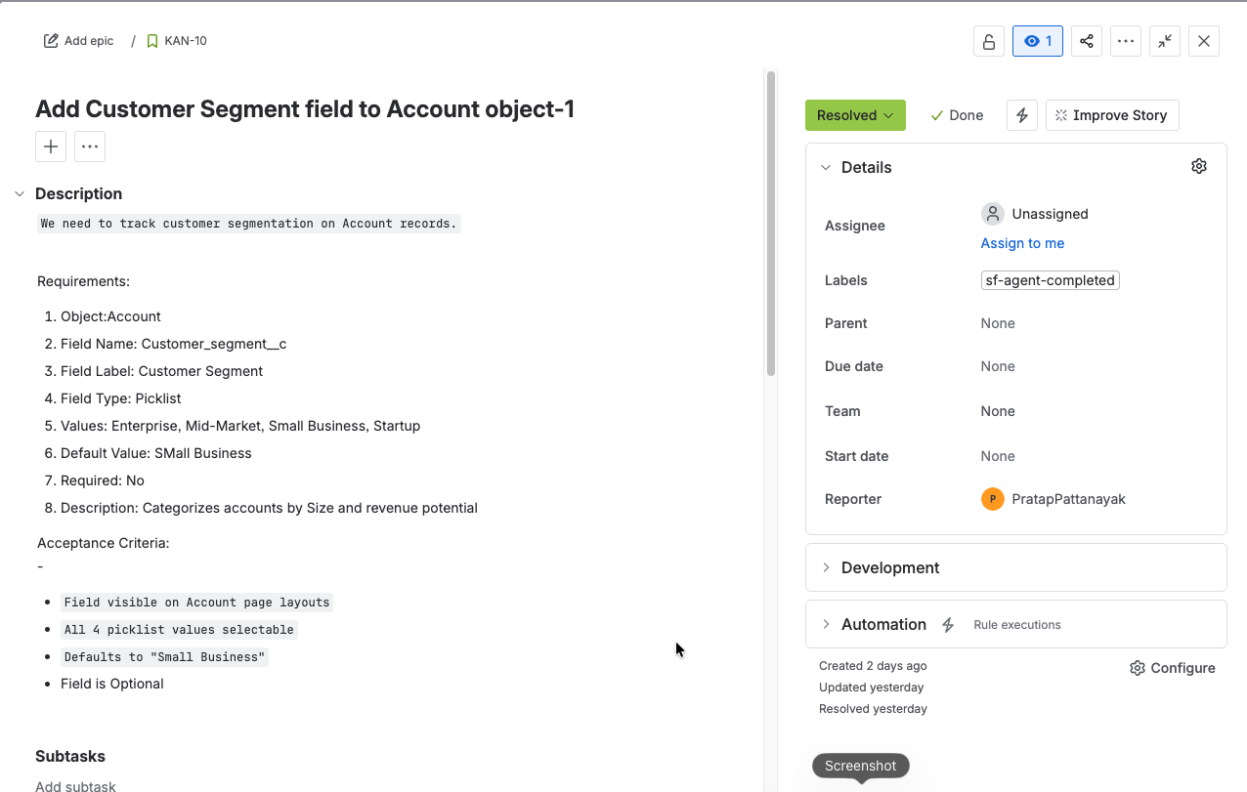
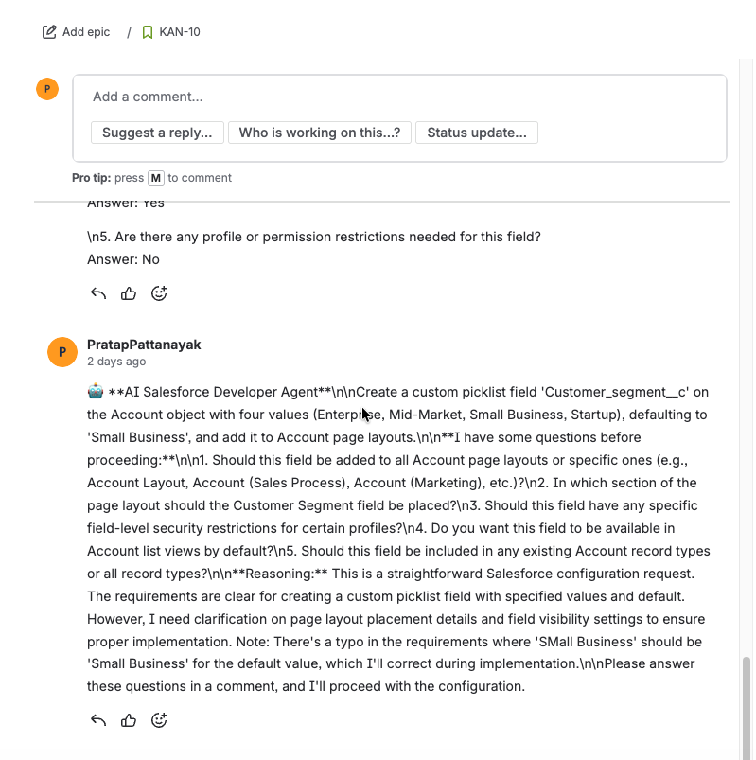
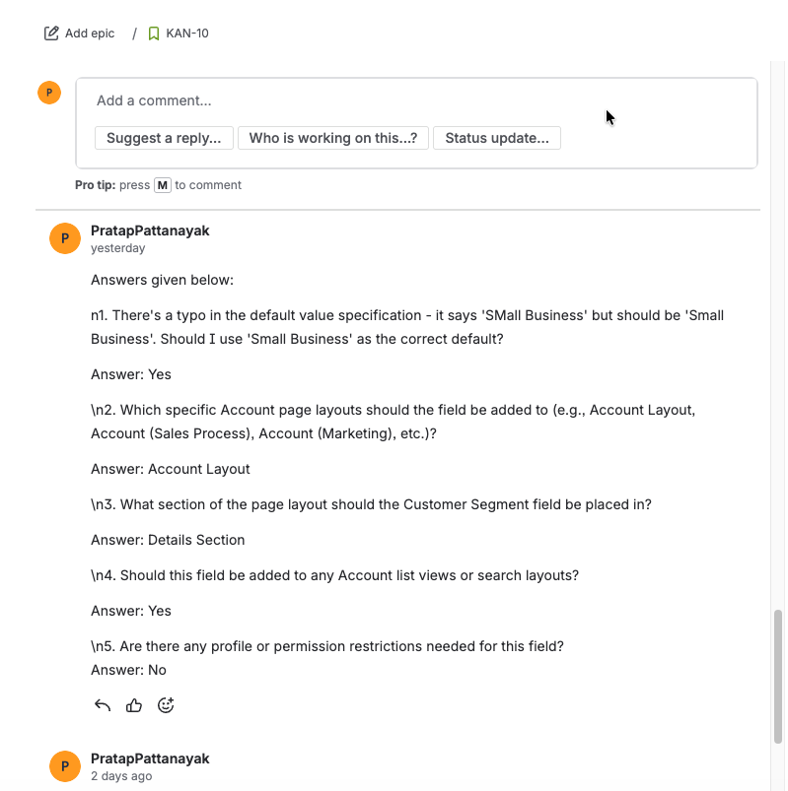
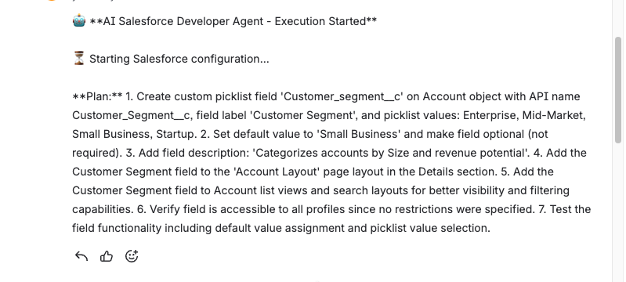
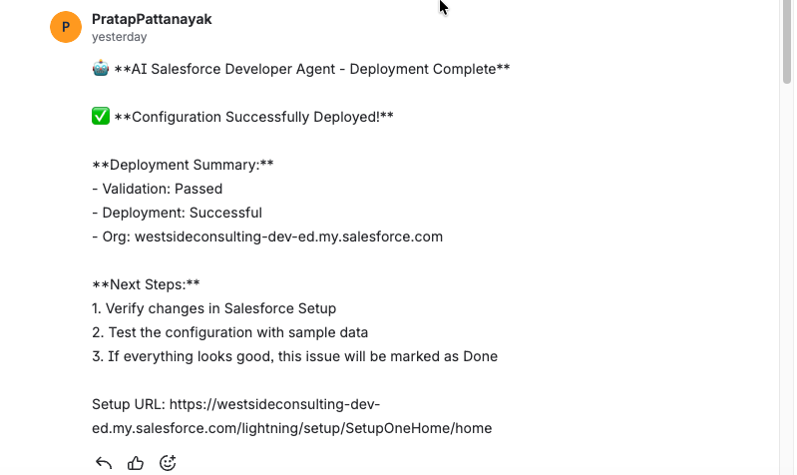
Real Deployment: Customer Segment Picklist

Slide 13
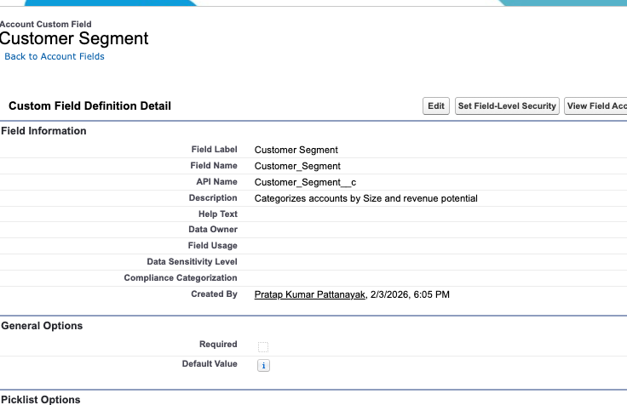
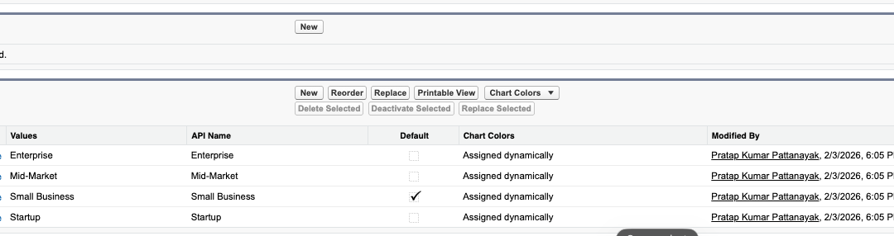
Post deployment Screenshot in Salesforce

Slide 14
Execution Timeline
13:45:00 - Story created with "salesforce" label
13:45:30 - Workflow 1: Claude analyzes requirement
13:45:45 - Workflow 1: Determines ready to execute (no questions)
13:45:50 - Workflow 1: Adds "ready-to-execute" label
13:45:55 - Workflow 1: Triggers Workflow 3 via webhook
13:46:00 - Workflow 3: Validates label and posts "Starting..."
13:46:05 - Workflow 3: Claude generates Tooling API metadata
13:46:15 - Workflow 3: Prepares and validates request
13:46:20 - Workflow 3: Deploys to Salesforce
13:46:30 - Workflow 3: Verifies deployment success
13:46:35 - Workflow 3: Posts success comment and marks Done

Slide 15
Security Measures
Authentication
✅ Salesforce OAuth2: Token-based auth with refresh
✅ Jira API Token: Stored in n8n credentials manager
✅ Anthropic API Key: Encrypted at rest
✅ Webhook URLs: Unique, non-guessable paths
Data Protection
✅ No credentials in code: All in n8n vault
✅ No sensitive data logging: Sanitized debug output
✅ Secure transmission: HTTPS only
✅ Least privilege: Minimal required permissions
Compliance
✅ GDPR: No PII stored outside systems of record
✅ SOC 2: Follows security best practices
✅ Change management: All changes tracked and reversible

Slide 16
Potential Roadmap…
Phase 2: Extended Functionality
🔄 Workflow Rules & Flows: Automate process creation
🎨 Page Layouts: Automatically add fields to layouts
🔐 Permission Sets: Manage field-level security
📋 Record Types: Create and assign record types
Phase 3: Advanced Features
🧪 Test Data Generation: Auto-create test records
📸 Screenshots: Capture before/after in Salesforce
🔄 Rollback System: One-click undo deployments
📊 Impact Analysis: Predict downstream effects
🌐 Multi-Org: Deploy to multiple Salesforce instances
Phase 4: AI Enhancements
🤖 Natural language input: "Add a picklist for industry"
🔍 Smart suggestions: AI recommends similar fields
📚 Learning system: Improve from past deployments
🎯 Auto-optimization: Suggest performance improvements
💬 Conversational UI: Chat-based requirement gathering

Slide 17
Results and Impact
Before Automation
⏱️ Time per field: 15-30 minutes
📝 Manual steps: 8-12 (UI clicks, validation, testing)
❌ Error rate: 15-20% (typos, wrong settings)
🔄 Context switching**: 3-4 tools (Jira, Salesforce, docs, Slack)
📊 Tracking: Manual status updates
After Automation
⚡ Time per field: 2-5 minutes (90% reduction)
🤖 Manual steps : 0 (fully automated)
✅ Error rate: <5% (AI validation + Tooling API)
🎯 Context switching: 1 tool (Jira only)
📊 Tracking: Automatic via labels & comments
Business Impact
💰 Cost savings: ~20 developer hours per week
🚀 Velocity increase: 5x faster deployments
📈 Quality improvement: 75% fewer configuration errors
😊 Developer satisfaction: Eliminates tedious tasks

Slide 18
Thank You
📧 pratap.pattanayak@gmail.com
💼 LinkedIn: https://www.linkedin.com/in/pratap2203/
🐙 GitHub: https://github.com/pratapsfdc22-dev

